Slide 1


Department of BES-I
COURSE: Data Structures
COURSE CODE: 24SC1203
Topic:
Name of the topic:
Infix to Postfix Conversion
Session – 16

Slide 2



AIM OF THE SESSION
To familiarize students with the basic concept of Infix notation . The aim of converting an infix expression to a postfix expression is primarily related to the way mathematical expressions are evaluated by computers
INSTRUCTIONAL OBJECTIVES
This Session is designed to:
Demonstrate The infix to postfix conversion
What is Postfix expression?
Different methods to convert infix expression to the postfix expression.
Algorithm to convert infix to postfix
How to convert infix to postfix using stack
LEARNING OUTCOMES
At the end of this session, you should be able to:
Define and Simplifying the infix to postfix Expression Evaluation
Understanding of Notations
Learn how to use a stack data structure to manage operators and operands during the conversion process.
Enhance algorithmic thinking by designing and implementing an algorithm for converting infix to postfix expressions.

Slide 3
INFIX TO POSTFIX EXPRESSION INTRODUCTION
Infix expression: The expression of the form “a operator b”
(a + b) i.e., when an operator is in-between every pair of operands.
Postfix expression: The expression of the form “a b operator” (ab+) i.e., When every pair of operands is followed by an operator.
Example:
Input: ((A + B) – C * (D / E)) + F
Output: AB+CDE/*-F+

Slide 4
ALGORITHM TO CONVERT INFIX TO POSTFIX
Scan the infix expression from left to right.
If the scanned character is an operand, put it in the postfix expression.
If the precedence and associativity of the scanned operator are greater than the precedence and associativity of the operator in the stack [or the stack is empty or the stack contains a ‘(‘ ], then push it in the stack. ‘^‘ operator is right associative and other operators like ‘+‘,’–‘,’*‘ and ‘/‘ are left-associative.
Check especially for a condition when the operator at the top of the stack and the scanned operator both are ‘^‘. In this condition, the precedence of the scanned operator is higher due to its right associativity. So it will be pushed into the operator stack.

Slide 5
ALGORITHM ……contd.,
b. Check especially for a condition when the operator at the top of the stack and the scanned operator both are ‘^‘. In this condition, the precedence of the scanned operator is higher due to its right associativity. So it will be pushed into the operator stack.
In all the other cases when the top of the operator stack is the same as the scanned operator, then pop the operator from the stack because of left associativity due to which the scanned operator has less precedence.
Else, Pop all the operators from the stack which are greater than or equal to in precedence than that of the scanned operator.
After doing that Push the scanned operator to the stack. (If you encounter parenthesis while popping then stop there and push the scanned operator in the stack.)

Slide 6
ALGORITHM ……contd.,
4. If the scanned character is a ‘(‘, push it to the stack.
5. If the scanned character is a ‘)’, pop the stack and output it until a ‘(‘ is encountered, and discard both the parenthesis.
6. Repeat steps 2-5 until the infix expression is scanned.
7. Once the scanning is over, Pop the stack and add the operators in the postfix expression until it is not empty.
8. Finally, print the postfix expression.

Slide 7
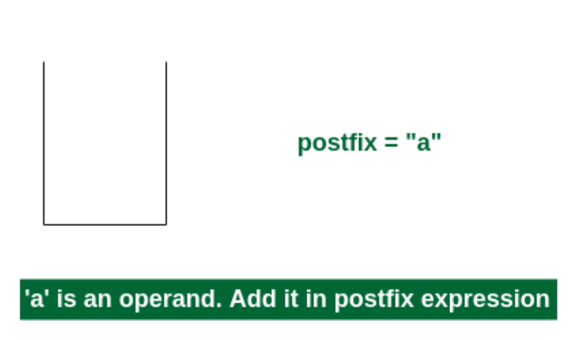
Examples of Infix to Postfix Expression
Consider the infix expression exp = “a+b*c+d”
1st Step: Here i = 0 and exp[i] = ‘a’ i.e., an operand. So add this in the postfix expression. Therefore, postfix = “a”.

Slide 8
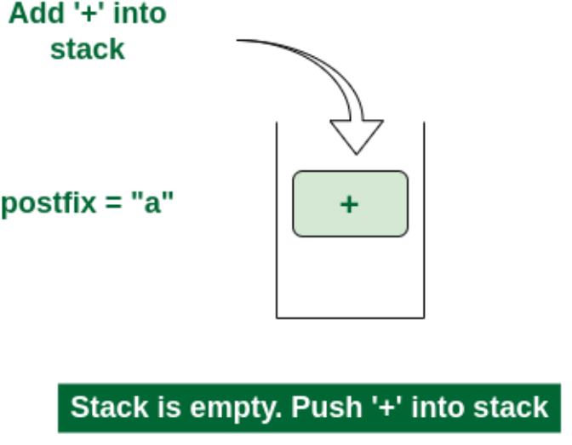
Examples of Infix to Postfix Expression…contd.,
2nd Step: Here i = 1 and exp[i] = ‘+’ i.e., an operator. Push this into the stack. postfix = “a” and stack = {+}.

Slide 9
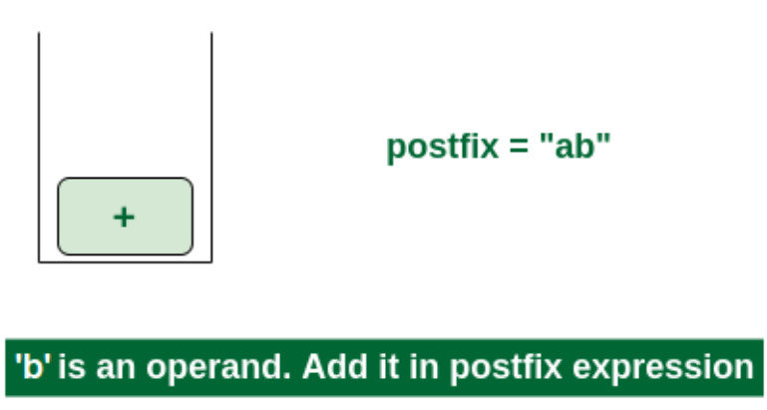
Example of Circular Linked list with 4 nod Examples of Infix to Postfix Expression…contd.,
es
3rd Step: Now i = 2 and exp[i] = ‘b’ i.e., an operand. So add this in the postfix expression. postfix = “ab” and stack = {+}.

Slide 10
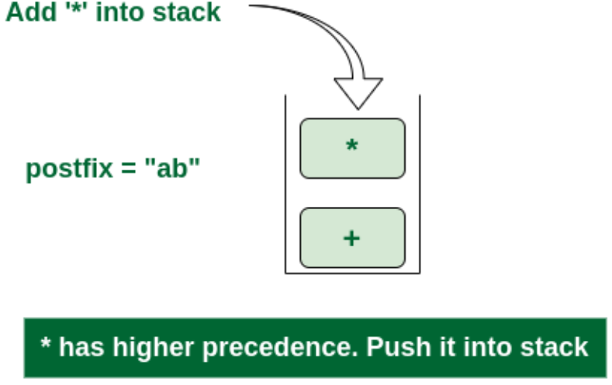
Examples of Infix to Postfix Expression…contd.,
4th Step: Now i = 3 and exp[i] = ‘*’ i.e., an operator. Push this into the stack. postfix = “ab” and stack = {+, *}.

Slide 11
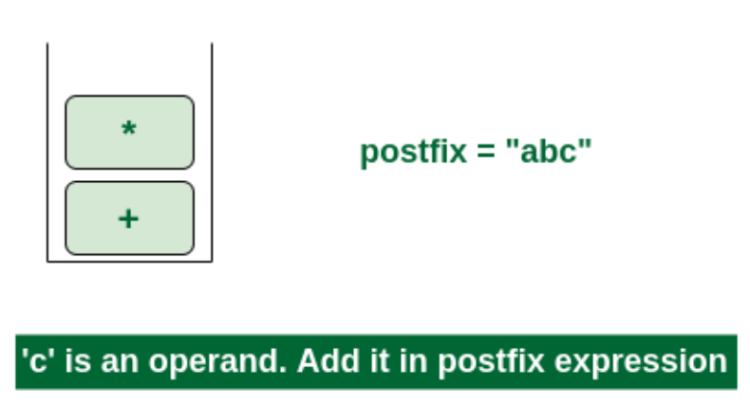
Examples of Infix to Postfix Expression…contd.,
5th Step: Now i = 4 and exp[i] = ‘c’ i.e., an operand. Add this in the postfix expression. postfix = “abc” and stack = {+, *}.

Slide 12
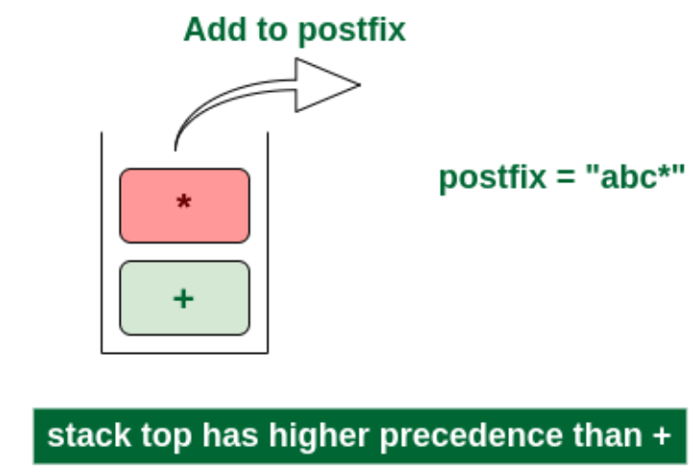
Examples of Infix to Postfix Expression…contd.,
6th Step: Now i = 5 and exp[i] = ‘+’ i.e., an operator. The topmost element of the stack has higher precedence. So pop until the stack becomes empty or the top element has less precedence. ‘*’ is popped and added in postfix. So postfix = “abc*” and stack = {+}.

Slide 13
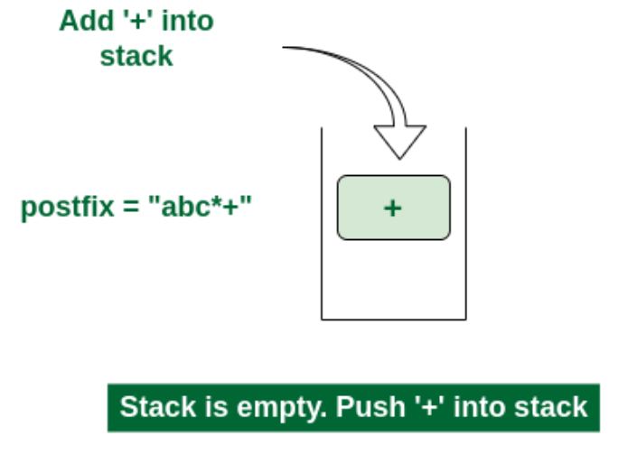
Examples of Infix to Postfix Expression…contd.,
Now stack is empty. So push ‘+’ in the stack. stack = {+}.

Slide 14
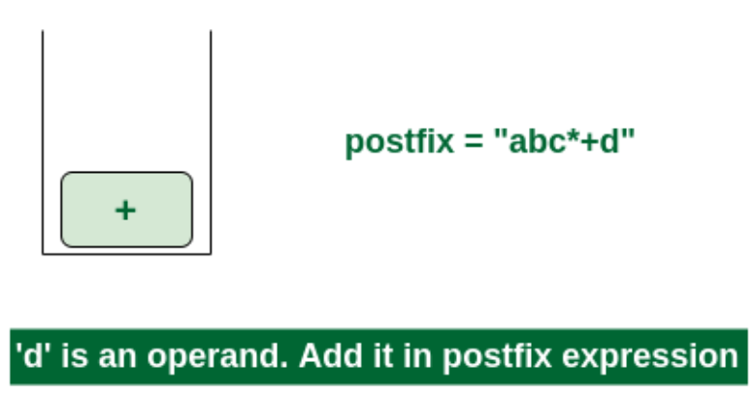
Examples of Infix to Postfix Expression…contd.,
7th Step: Now i = 6 and exp[i] = ‘d’ i.e., an operand. Add this in the postfix expression. postfix = “abc*+d”.

Slide 15
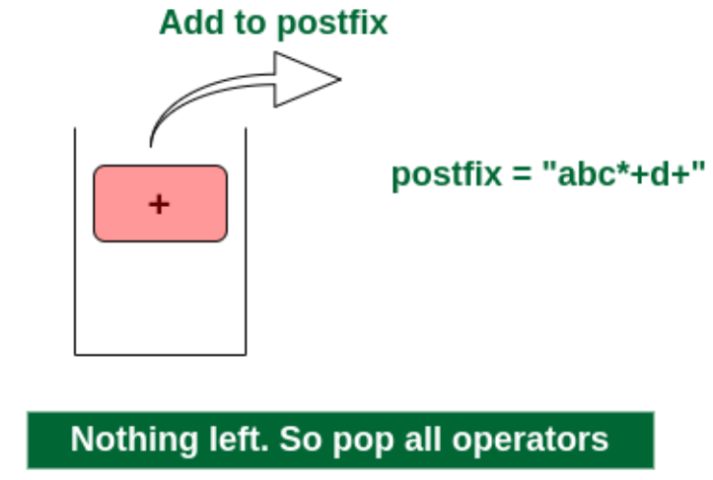
Examples of Infix to Postfix Expression…contd.,
Final Step: Now no element is left. So empty the stack and add it in the postfix expression. postfix = “abc*+d+”.

Slide 16
Implementation of Infix to Postfix Expression
#include <stdio.h>
#include <ctype.h>
char stack[100];
int top = -1;
void push(char x) {
stack[++top] = x;}
char pop() {
if (top == -1)
return -1;
else
return stack[top--];}
else if (*e == ')') {
while ((x = pop()) != '(') {
printf("%c ", x);
}
}
else {
while (top != -1 &&
((priority(stack[top]) > priority(*e)) ||
(priority(stack[top])==priority(*e)&&
isRightAssociative(*e) == 0))) {
printf("%c ", pop()); }
push(*e); }
e++;
}
while (top != -1) {
printf("%c ", pop());}
return 0;}
int priority(char x) {
if (x == '(')
return 0;
if (x == '+' || x == '-')
return 1;
if (x == '*' || x == '/' || x='%')
return 2;
if (x == '^')
return 3;
return -1;
}
int isRightAssociative(char x) {
if (x == '^') return 1;
return 0;}
int main() {
char exp[100];
char *e, x;
printf("Enter the expression: ");
scanf("%s", exp);
printf("\n");
e = exp;
while (*e != '\0') {
if (isalnum(*e)) {
printf("%c ", *e);}
else if (*e == '(') { push(*e); }

Slide 17
Advantages of Infix to postfix
Simplified Expression Evaluation
Efficient Expression Parsing
No Need for Operator Precedence Rules
Stack-Based Evaluation
Application in Calculator Design
Disadvantages of Infix to postfix
Human Readability
Expression Entry Difficulty
Learning Curve
Implementation Complexity.
Applications of Infix to postfix in real life
Mathematical Software and Symbolic Computation
Database Query Processing
Control Systems and Embedded Systems
Calculator Apps and Tools

Slide 18
PRACTICE PROBLEMS
1.A(B+C)-D/E
2.(A+B)-(D/E)
3.2+(6-8)*4/2
4.A+B*(C-D)*(D/E)+A/D
5. a+b*(c^d-e)^(f+g*h)-i

Slide 19
SUMMARY
infix Notation:
  Standard mathematical notation where operators are placed between their operands (e.g., 2 + 3).
Postfix Notation:
  Also known as Reverse Polish Notation (RPN), where operators come after their operands (e.g., 2 3 +).
Algorithm Steps:
  Initialize an empty stack.
  Scan the infix expression from left to right.
  For each symbol (operand or operator):
    If operand, output it directly.
    If operator:
      Pop operators from the stack and output them until an operator with lower precedence is encountered, then push the current operator onto the stack.
      If an open parenthesis is encountered, push it onto the stack.
      If a close parenthesis is encountered, pop operators from the stack and output them until an open parenthesis is encountered. Pop and discard the open parenthesis.
  After scanning the entire expression, pop any remaining operators from the stack and output them.

Slide 20
SELF-ASSESSMENT QUESTIONS
What is the postfix expression for the corresponding infix expression?
a+b*c+(d*e)
a) abc*+de*+
b) abc+*de*+
c) a+bc*de+*
d) abc*+(de)*+
2. Which of the following statement is incorrect with respect to infix to postfix conversion algorithm?
a) operand is always placed in the output
b) operator is placed in the stack when the stack operator has lower precedence
c) parenthesis are included in the output
d) higher and equal priority operators follow the same condition

Slide 21
TERMINAL QUESTIONS
When an operand is read, which of the following is done?
What should be done when a left parenthesis ‘(‘ is encountered?
What is the time complexity of an infix to postfix conversion algorithm?
Parentheses are simply ignored in the conversion of infix to postfix expression.
It is easier for a computer to process a postfix expression than an infix expression.
Which of the following statement is incorrect with respect to infix to postfix conversion algorithm?
In infix to postfix conversion algorithm, the operators are associated from?
What is the corresponding postfix expression for the given infix expression?

Slide 22
REFERENCES FOR FURTHER LEARNING OF THE SESSION
Reference Books:
  Mark Allen Weiss, Data Structures and Algorithm Analysis in C, 2010 , Second Edition, PearsonEducation.
  2. Ellis Horowitz, Fundamentals of Data Structures in C: Second Edition, 2015
  A.V.Aho, J. E. Hopcroft, and J. D. Ullman, “Data Structures And Algorithms”, Pearson Education, First Edition Reprint2003.
Sites and Web links:
https://panda.ime.usp.br/pythonds/static/pythonds_pt/02-EDBasicos/InfixPrefixandPostfixExpressions.html
https://www.javatpoint.com/convert-infix-to-postfix-notation
https://www.scaler.com/topics/infix-to-postfix-conversion/

Slide 23
THANK YOU
Team – Data Sructures

